Slide 1
Optimal computation of avoided words
Hélène Perée
Madalina Ciortan

Slide 2
From formal language theory to genomics
DNA sequences = words on a fixed sized alphabet
Non/Coding DNA has many statistical features common with natural languages (EX)
DNA avoided words:
Destabilize chromatin/genomic conformation
Target of restriction endonuclease
Signaling roles (initiation of transcription/DNA replication)
Insulators
Functions yet to be discovered

Slide 3
Terminology
Alphabet/ Word/ Occurrence
Integer alphabet : letters is replaced by rank : {1,…,n}
Factor of x = substring of x from i to j
Prefix = factor that starts at position 0 (x[0…j]x[0…j])
Suffix = factor that ends at position n−1 (x[i…n−1])
Infix = factor that is neither a prefix nor a suffix of x
Absent word in a sequence = segment that doesn’t occur in the sequence
Minimal absent word = all its proper factors occur in given sequence
Word-depth of node v : D(v)=|L(v)|

Slide 4
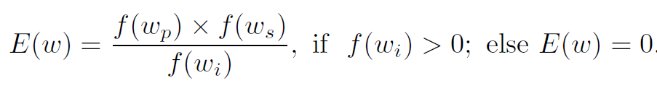
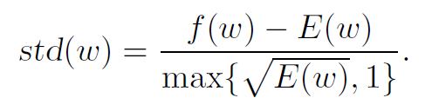
Metrics
Expected frequency
Standard deviation
Objective : std(w) ≤ ρ

Slide 5
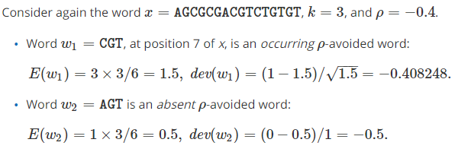
Example

Slide 6
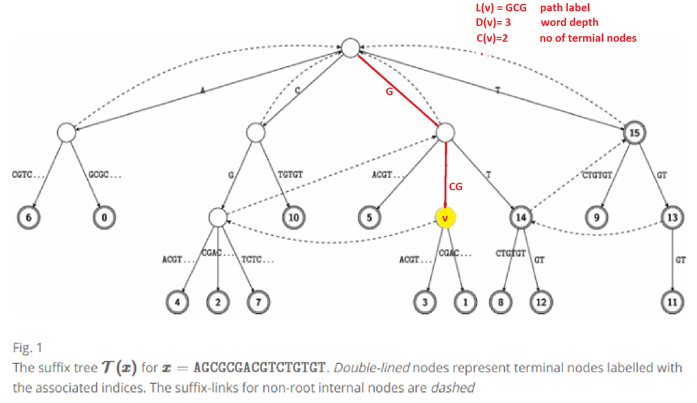
Suffix trees
Implicit/explicit nodes
Word depth
Terminal node
Suffix link
Child(v, a)

Slide 7
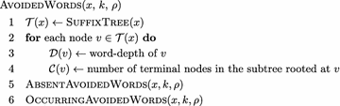
Algorithms
O(n) time complexity- avoided words of length k
O(σn) time complexity - avoided words of any length

Slide 8
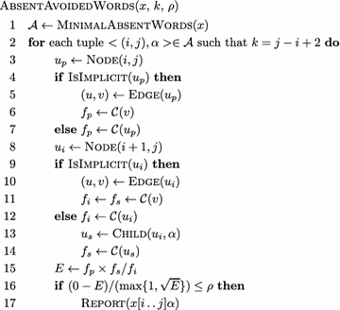
Absent avoided words

Slide 9
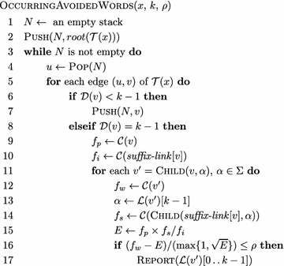
Occurring avoided words

Slide 10
Theorems and lemmas
The paper proves mathematically the following points:
Any absent ρρ-avoided word w in x is a minimal absent word of x.
etc

Slide 11
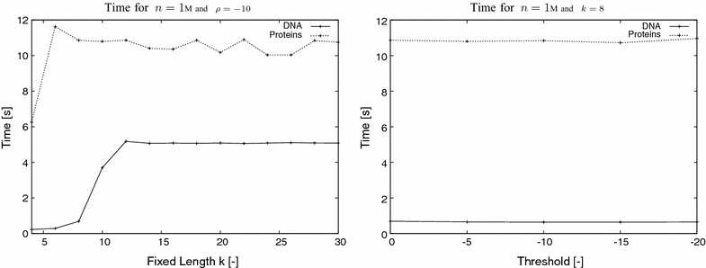
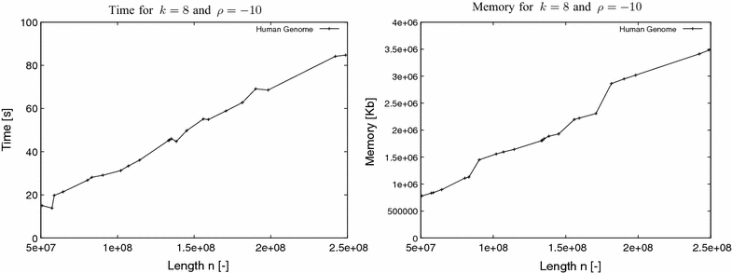
Experimental results

Slide 12
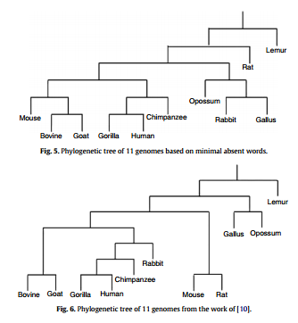
Applications Building phylogeny with minimal absent words
Absent words
Negative selection
Sequence evolution/ comparative genomics / genetic engineering
Length-weighted index to compute the similarity/dissimilarity between sequences based on the minimal absent words
Technique applied to the first axon of B globin -> phylogeny of 11 organisms

Slide 13
Applications Data compression using antidictionaries
When processing i-th letter of input and there is a word v[1..n] in antidictionary, that v[1..n-1] is a suffix of previously processed input, we don't need to code i-th letter into output, because (when decoding) we can find that letter with a help of the suffix and the antidictionary.
Other input letters are normally copied to output.

Slide 14
Conclusions

Slide 15
References
https://almob.biomedcentral.com/articles/10.1186/s13015-017-0094-z
Building Phylogeny with Minimal Absent Words https://link.springer.com/chapter/10.1007/978-3-642-22256-6_10
Data compression using antidictionaries
http://www.stringology.org/DataCompression/dca/index_en.html
https://hal.inria.fr/file/index/docid/619991/filename/9806-TC.pdf

